Slide 1
What is RSV and why does it matter?
Notes:
What is RSV: what, seasonality, transmission, symptoms, risk factors
Why does it matter: burden, preventive strategies, global andequitable vaccine uptake

Slide 2
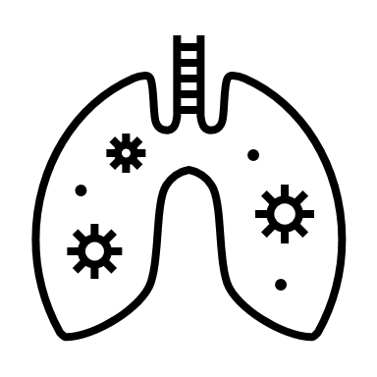
RSV stands for Respiratory Syncytial Virus
Everyone contracts RSV at some point in their lives
Young children and elderly persons are at risk of severe illness due to RSV infection

Slide 3
Transmission of RSV
Aerosol transmission
Sneezing
Coughing
Breathing
Contact with contaminated surfaces then eyes, nose, or mouth

Slide 4
Seasonality of RSV
RSV season in the Northern Hemisphere: Approximately November - March
RSV season in the Southern Hemisphere:
Approximately June - September (rainy season)
There are variations in regions and even within countries
Seasonality can also change over time

Slide 5
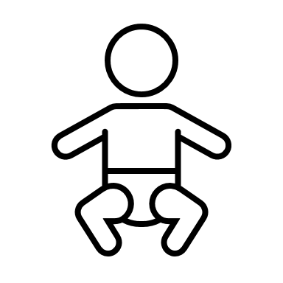
RSV presentation
RSV infection in infants can result in severe illness or death
Signs can include:
Runny nose
Coughing and sneezing
Fever
Difficulty feeding
Shortness of breath or wheezing
Intercostal retractions

Slide 6
Risk factors for severe RSV infection
Age Premature birth <36 weeks gestational age
Age <6 months
Age 65+ years
Comorbidities Including heart diseases, chronic lung diseases, Down’s Syndrome.
Others
Malnutrition, HIV/AIDS, limited access to healthcare.
1
2
3

Slide 7
Estimated burden of RSV < 5 years (2019)
33,000,000
Severe cases
3,600,000
Hospitalisations
101,000
Deaths
RSV is the leading cause of severe respiratory infections worldwide
RSV is the leading cause of pediatric hospitalization worldwide
RSV is secondary cause of pediatric mortaility worldwide
Babies <6 months account for nearly half of all RSV-deaths
Yi Lancet 2022

Slide 8
RSV-associated mortality
99%
Of the mortality cases occurs in LMICs
Notes:
RSV is just as common in low- and middle-income areas of the world as in high-income ones. Despite RSV’s global reach, however, over 98% of pediatric RSV deaths occur in low- and middle-income economies where many children never make it to hospital.1 In fact, RSV deaths before 6 months of age in low-income areas are 4 times likelier to occur in the community than in the hospital.

Slide 9
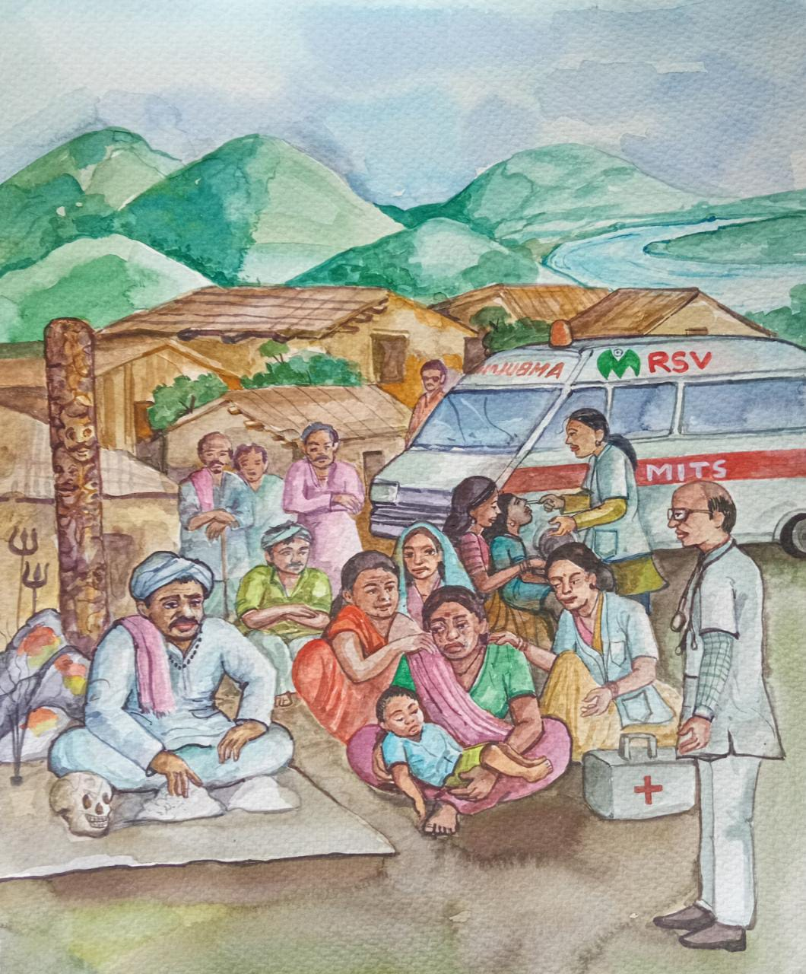
RSV-associated mortality
In-hospital
$\frac{1}{1−10}$
In-community
Nair Lancet 2010
Simoes CID 2021
Mazur CID 2021
Notes:
RSV deaths before 6 months of age in low-income areas are 4 times likelier to occur in the community than in the hospital.

Slide 10
Prevention of RSV-associated mortality
Prevent transmission
Sneezing
Coughing
Breathing
Supportive care
Palivizumab
Nirsevimab*
Monoclonal antibody prevention
Hydration
Nutritional support
Oxygen and ventilation
Vaccination
Maternal vaccination during pregnancy*

Slide 11
Why focus on preventive strategy implementation now?
New, game-changing tools for preventing RSV in early life are now achieving or on the pathway to licensure
Long-acting monoclonal antibodies
Maternal vaccination

Slide 12
New interventions to prevent infant RSV
 | Monoclonal antibody (Nirsevimab) | Maternal vaccination
How | Immunizing neonates after birth. | Vaccination in pregnancy induces natural antibody transfer to baby.
Timing | Directly after birth. | Late second or third trimester during pregnancy (during antenatal care).
Frequency | One dose --> at least 5-6 months protection. | One dose --> at least 5-6 months protection after birth.
Notes:
Explain difference between monoclonal antibody and maternal vaccination

Slide 13
RSV immunization could...
...keep children out of the hospital
...save many young lives
...free up resources for other health priorities

Slide 14
Vaccine uptake depends on awareness
Currently RSV awareness is low amongst patients, policy makers and health-care providers.
RSV awareness is crucial for global vaccine acceptance and implementation

Slide 15
Vaccine uptake depends on awareness
Vaccine
implementation

Slide 16
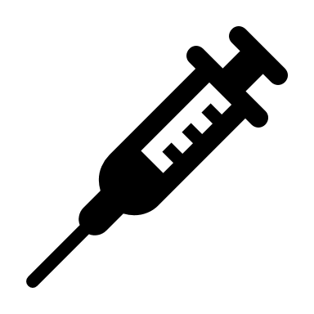
Take-home message
What
Where
Who
Next
RSV is the second leading cause of global childhood mortality
99% of RSV-associated deaths occur in LMIC, mostly out of hospital
Children with severe RSV: the majority is <6 months of age.
Raising awareness to promote vaccine acceptance & implementation

Slide 17
Will you join our mission?
Write your e-mail address in the chat
or
send an e-mail to rsvgold@umcutrecht.nl
and
Visit our website: www.rsvgold.com/100xGOLD

Slide 18
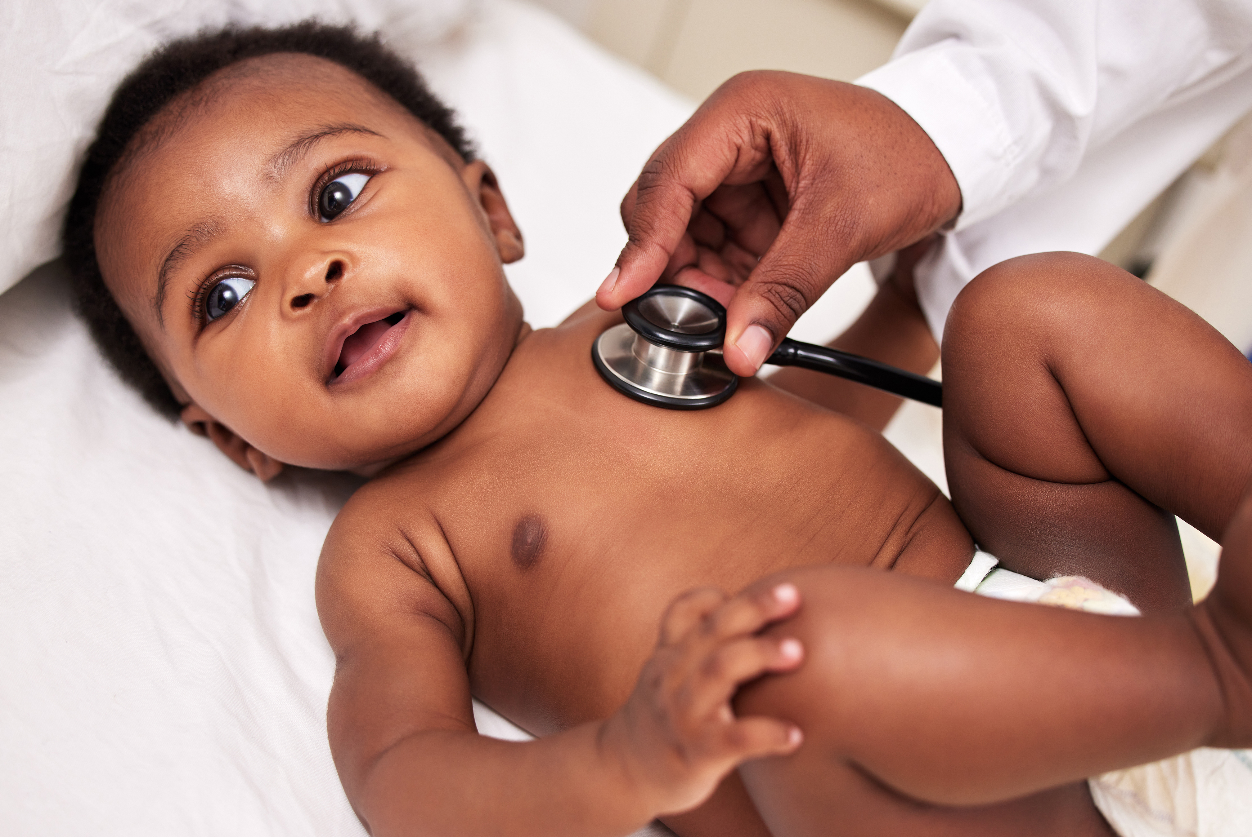
Thank you!
For more information, please contact: RSVGOLD@umcutrecht.nl

