Slide 1
What is RSV and why does it matter?
Notes:
What is RSV: what, seasonality, transmission, symptoms, risk factors
Why does it matter: burden, preventive strategies, global andequitable vaccine uptake

Slide 2
Agenda
RSV disease burden
Forthcoming prevention strategies
The magnitude and distribution of this under-recognized public health problem
Long-acting monoclonal antibodies and maternal vaccination
The road to equitable RSV prevention
Ungoing work, possibilities and challenges.
Clinical disease
Transmission, symptoms and treatment

Slide 3

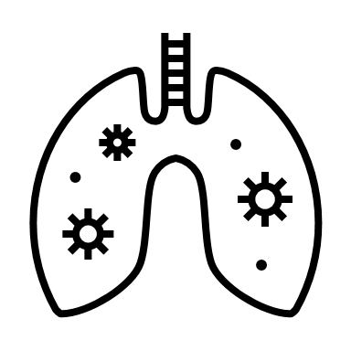
RSV stands for Respiratory Syncytial Virus
RSV is worldwide the second cause of death in children <5 years of age
Young children and elderly persons are at risk of severe illness due to RSV infection

Slide 4



Annual global paediatric burden of RSV < 5 years
33,000,000
Severe cases
3,600,000
Hospitalisations
101,000
Deaths
RSV is the leading cause of severe respiratory infections worldwide
RSV is the leading cause of pediatric hospitalization worldwide
RSV is second largest cause of pediatric mortaility worldwide
Babies <6 months account for nearly 50% of all RSV-deaths
Yi Lancet 2022

Slide 5


The youngest children are the most vulnerable
RSV is most severe in first few months of life due to easily blocked small airways.
Birth
6 months
1 IN EVERY 28 DEATHS
before 6 months of age globally is due to RSV
PERCH study group Lancet 2019

Slide 6
RSV-associated mortality
97%
Of the mortality cases occurs in LMICs
For every 1
in-hospital death
4 estimated communal deaths
Yi Lancet 2022
Notes:
RSV is just as common in low- and middle-income areas of the world as in high-income ones. Despite RSV’s global reach, however, over 98% of pediatric RSV deaths occur in low- and middle-income economies where many children never make it to hospital.

Slide 7




Economic Burden
Bangladesh¹
24-32%
Of monthly income for families per RSV Hospitalization
Bangladesh¹
$10M USD
Median annual direct costs of RSV hospitalizations
Economic burden is substantial in high- and low-income countries on health-systems and households
More Health-Economics data is needed to inform decision-making on RSV prevention
Bhuiyan MU, J Glob Health. 2017

Slide 8
Transmission of RSV
Aerosol transmission
Sneezing
Coughing
Breathing
Contact with contaminated surfaces then eyes, nose, or mouth

Slide 9

Seasonality of RSV
RSV season in the Northern Hemisphere:
Approximately November - March
RSV season in the Southern Hemisphere:
Approximately June - September (rainy season)
There are variations in regions and even within countries
Seasonality can also change over time

Slide 10






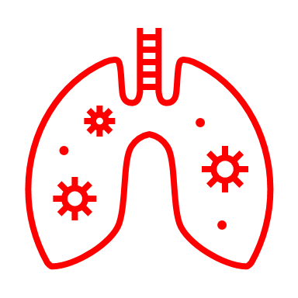
RSV clinical presentation
Virus
inhalation
Incubation 4-6 days
Upper
RTI
Lower
RTI
Severe infection
No symptoms
Runny nose
Fever (≥38C)
Poor feeding
Coughing
DIB
Thoracic retractions
Wheezing
Severe hypoxemia

Slide 11
Risk factors for severe RSV infection
Age
Premature birth <36 weeks gestational age
Age <6 months
Age 65+ years
Comorbidities
Including heart diseases, chronic lung diseases, Down’s Syndrome.
Others
Malnutrition, HIV/AIDS, limited access to healthcare.
1
2
3

Slide 12
Prevention of RSV-associated mortality
Prevent transmission
Sneezing
Coughing
Breathing
Supportive care
Palivizumab
Nirsevimab*
Monoclonal antibody prevention
Hydration
Nutritional support
Oxygen and ventilation
Vaccination
Maternal vaccination during pregnancy*

Slide 13




Why focus on preventive strategy implementation now?
New, game-changing tools for preventing RSV in early life are now achieving or on the pathway to licensure
Long-acting monoclonal antibodies
Maternal vaccination

Slide 14
Why do we need maternal vaccination & long lasting mAb?
Thesis Nienke Scheltema 2018 based on Van der Maas NTVG 2016

Slide 15


New interventions to prevent infant RSV
 | Monoclonal antibody (Nirsevimab) | Prefusion F Maternal vaccine
How | Immunizing neonates soon after birth | Vaccination in pregnancy induces natural antibody transfer to baby
Timing | Directly after birth or at first Expanded Program on Immunization (EPI) visit | Late second or third trimester during pregnancy possibly during antenatal care (ANC)
Frequency | One dose --> at least 5-6 months protection | One dose --> at least 5-6 months protection after birth
Notes:
Explain difference between monoclonal antibody and maternal vaccination

Slide 16
Promising trial results on infant RSV prevention
 | Monoclonal antibody (Nirsevimab)¹ | Prefusion F Maternal vaccine²
Efficacy RSV-associated LRTI | 76.4% 150 days after injection | 51.3% 180 days after birth
Efficacy Severe RSV-associated LRTI | 78.6% 150 days after injection | 69.4% 180 days after birth
Efficacy Hospitalization for RSV-associated LRTI | 76.8% 150 days after injection | 56.8% 180 days after birth
Other considerations | No safety concerns identified Price and access barriers | No safety concerns identified
¹Hammit NEJM 2022; ²Kampmann NEJM 2023

Slide 17
Vaccine Timeline
EMA & FDA approval
Earliest possible SAGE review
EMA & FDA approval
Earliest possible SAGE review
Earliest possible WHO Prequalification
Uncertain if it will be submitted WHO Prequalification
Monoclonal antibody
(Nirsevimab)
2023
2024
2025
Prefusion F Maternal vaccine
EMA = European Medical Agency; FDA = US Food and Drug Administration
SAGE = WHO Scientific Advisory Group of Experts; PQ = Prequalification

Slide 18


RSV immunization could...
...keep children out of the hospital
...save many young lives
...free up resources for other health priorities

Slide 19
The road to Vaccine implementation and uptake
WHO prequalification
Increases availability of quality assured-medicines
Evidence based decision to prioritize RSV prevention
Requires health-economic evidence, raised awareness and supportive policy and finance.
Efficient and equitable vaccine delivery
Requires preparations at Antenatal care and Expanded program of immunization logistics and operational capacity

Slide 20
Vaccine uptake depends on awareness
Currently RSV awareness is low amongst patients, policy makers and health-care providers.
RSV awareness is crucial for global vaccine acceptance and implementation

Slide 21
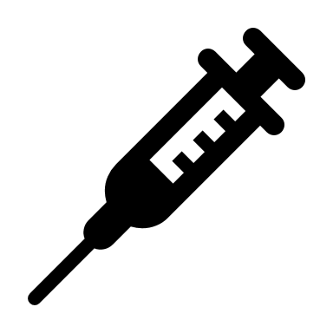
Take-home message
What
Where
Who
Next
RSV is the second leading cause of global childhood mortality
97% of RSV-associated deaths occur in LMIC, mostly out of hospital
Children with severe RSV: the majority is <6 months of age.
Raising awareness to promote vaccine acceptance & implementation

Slide 22

Will you join our mission?
send an e-mail to rsvgold@umcutrecht.nl
and
Visit our website: www.rsvgold.com

Slide 23
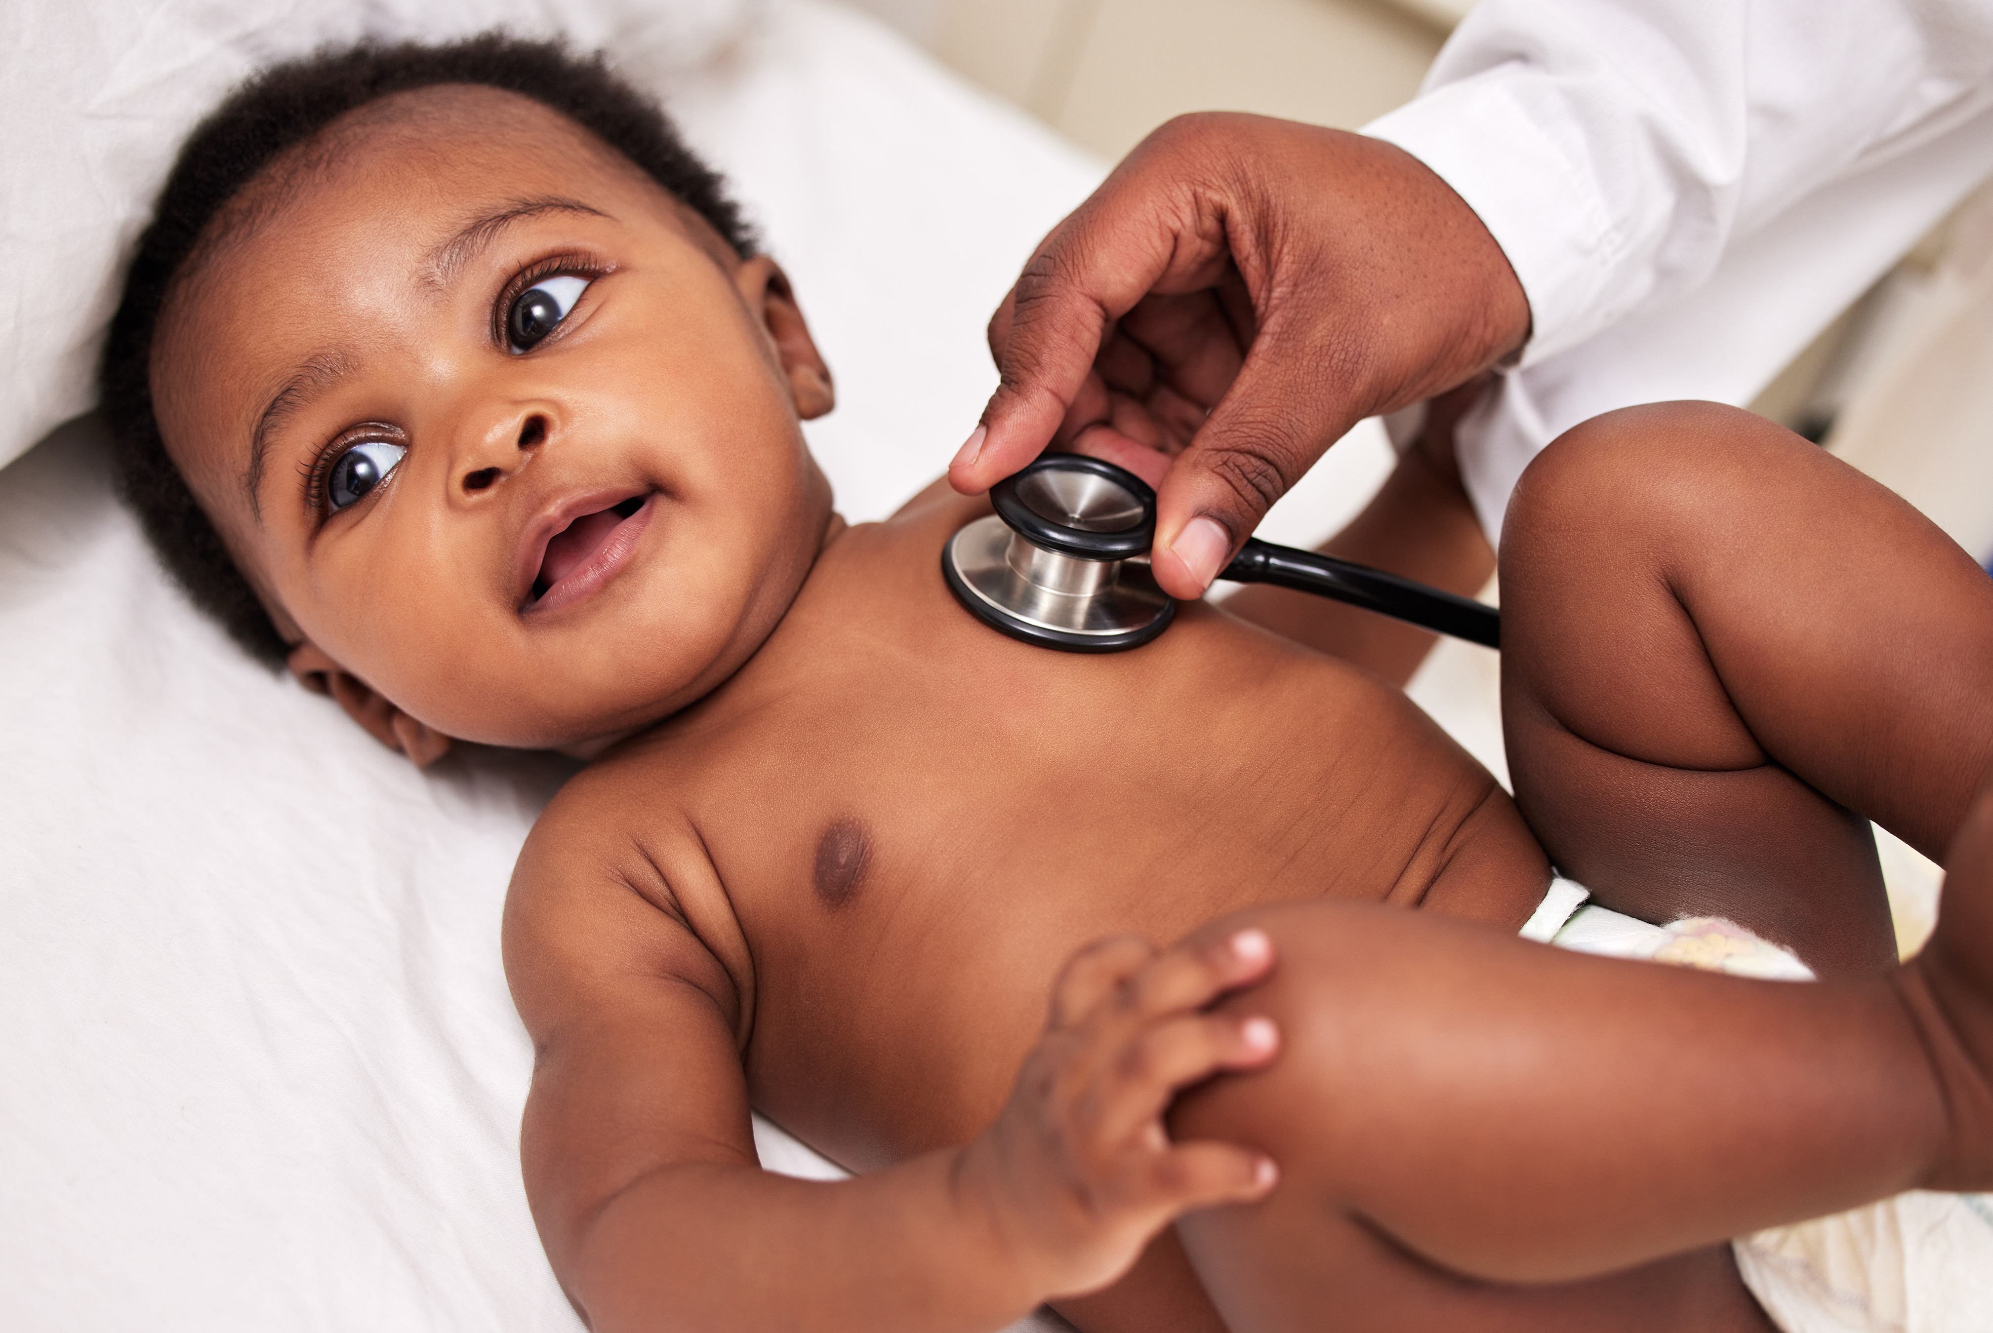
Thank you!
For more information, please contact:
rsvgold@umcutrecht.nl

